Slide 1

Capstone Project
Hotel Booking Analysis
Kaushik Dey
Arkadyuti Dhara
(Cohort Istanbul)

Slide 2
Problem Statement:
In this project we are going to explore Hotel Booking dataset. This dataset contains various information about City and Resort Hotel. The hotel industry is highly competitive, and hotels face numerous challenges in maximizing revenue, enhancing customer experiences, and optimizing operations. hotel industry is one of the most important components of the wider service industry and very much profitable. So the main priority of hotel owner is to provide the highest possible level of hospitality to the guests. Hotel booking analysis plays a crucial role in addressing these challenges by leveraging data-driven insights to make informed decisions.
In this presentation, we aim to analyze hotel booking data to uncover valuable insights that can help hotels improve their business strategies and achieve their objectives

Slide 3
Work flow:
Eda is divided into 3 parts:
1) Univariate Analysis: analysis with one column.
2) Bivariate Analysis: analysis with two columns.
3) Multivariate Analysis: analysis with more then two columns.
Data Collection &Understanding
Data cleaning & Wrangling
Exploratory Data Analysis(EDA)

Slide 4
Data Collection & Understanding
Data collection and understanding is very important. So in dataset contains 119390 rows and 32 columns. Let’s understand the columns.
Dataset Description:
Given data set has different columns of variables crucial for hotel bookings. Some of them are:
hotel : Hotel(Resort Hotel or City Hotel) is_canceled : Value indicating if the booking was canceled (1) or not (0)
lead_time : * Number of days that elapsed between the entering date of the booking into the PMS and the arrival date*
arrival_date_year : Year of arrival date
arrival_date_month : Month of arrival date
arrival_date_week_number : Week number of year for arrival date
arrival_date_day_of_month : Day of arrival date

Slide 5
Data Collection & Understanding
stays_in_weekend_nights : Number of weekend nights (Saturday or Sunday) the guest stayed or booked to stay at the hotel
stays_in_week_nights : Number of week nights (Monday to Friday) the guest stayed or booked to stay at the hotel
adults : Number of adults
children : Number of children
babies : Number of babies
meal : Type of meal booked. Categories are presented in standard hospitality meal packages:
country : Country of origin.`
market_segment : Market segment designation. In categories, the term “TA” means “Travel Agents” and “TO” means “Tour Operators”

Slide 6
Data Collection & Understanding
distribution_channel : Booking distribution channel. The term “TA” means “Travel Agents” and “TO” means “Tour Operators”
is_repeated_guest : Value indicating if the booking name was from a repeated guest (1) or not (0)
previous_cancellations : Number of previous bookings that were cancelled by the customer prior to the current booking
previous_bookings_not_canceled : Number of previous bookings not cancelled by the customer prior to the current booking
reserved_room_type : Code of room type reserved. Code is presented instead of designation for anonymity reasons.
assigned_room_type : Code for the type of room assigned to the booking.
booking_changes : Number of changes/amendments made to the booking from the moment the booking was entered on the PMS until the moment of check-in or cancellation

Slide 7
Data Collection & Understanding
deposit_type : Indication on if the customer made a deposit to guarantee the booking.
agent : ID of the travel agency that made the booking
company : ID of the company/entity that made the booking or responsible for paying the booking.
days_in_waiting_list : Number of days the booking was in the waiting list before it was confirmed to the customer
customer_type : Type of booking, assuming one of four categories
adr : Average Daily Rate as defined by dividing the sum of all lodging transactions by the total number of staying nights
required_car_parking_spaces : Number of car parking spaces required by the customer
total_of_special_requests :Number of special requests made by the customer (e.g. twin bed or high floor)*

Slide 8
Data collection & understanding:
reservation_status : Reservation last status, assuming one of three categories
Canceled – booking was canceled by the customer
Check-Out – customer has checked in but already departed
No-Show – customer did not check-in and did inform the hotel of the reason why
reservation_status_date : Date at which the last status was set. This variable can be used in conjunction with the Reservation Status to understand when was the booking canceled or when did the customer checked-out of the hotel

Slide 9
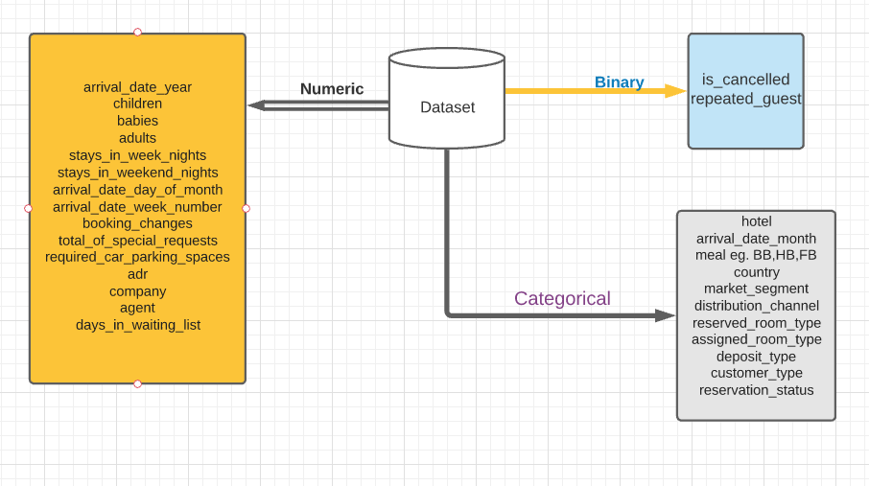
Data Summary

Slide 10
Data Cleaning and Wrangling:
Handling duplicates values: In this dataset there was 31994 duplicates values . So we dropped it from dataset
We have found 4 missing values columns named as company and country, agent and children
missing Values Percentage missing Values
children 4 0.004577
country 452 0.517186
agent 12193 13.951439
company 82137 93.982562
As we can see company had almost 94% missing values and agent also had 14% then country and children columns had very few missing values.

Slide 11
Data cleaning and wrangling:
Handling Missing Values:
filled null values in agent with 0 assuming those rooms were booked without any agents
data["agent"].fillna(0,inplace=True)
replaced null values in children with 0 assuming 0 children in that family
data["children"].fillna(0,inplace=True)
Filled null values in Country with 'Other' category assuming tourist belong to country other than available list
data["country"].fillna('other',inplace = True)
We dropped company column because it contains 94% null data
data.drop(['company'], axis=1, inplace=True)

Slide 12
Feature Engineering
Data Type change to suitable format for further the variable “Reservation Status’’.The variable has been parsed to datetime format (a library of pandas) i.e. Year-Month-Day format.
data['reservation_status_date’] = pd.to_datetime(data['reservation_status_date'], format = '%Y-%m-%d’)
Adding New Columns by the help of existing columns like
1.Total People with the help of ‘‘Adults, Children and Babies’’
2.Kids with the help of ‘‘Children and Babies’’
3.Total Stays we get by using Stays in ‘‘Weekend Nights and Stays in Week Nights.’’

Slide 13

DATA VISUALIZATION, STORYTELLING & EXPERIMENTING WITH CHARTS: Understand the relationships between Variables

Slide 14
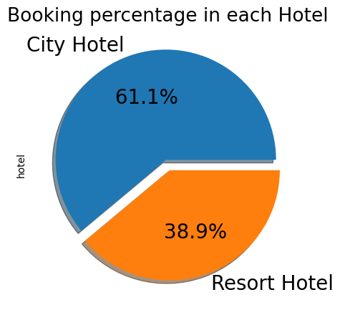
DATA VISUALISATION:
Booking Percentage of different types of Hotels
Inference:
Majority of guest prefer City Hotels over Resort Hotels
2/3rd of total guest

Slide 15
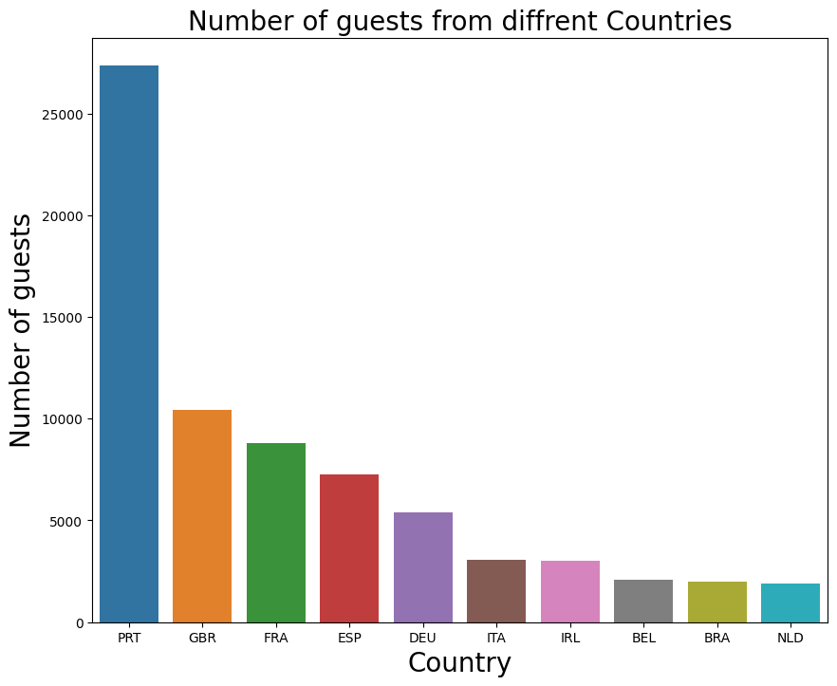
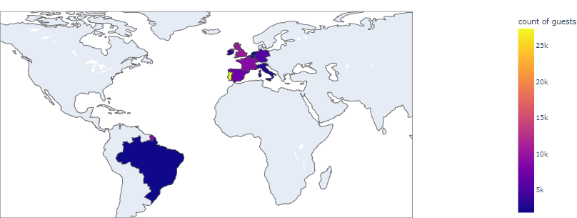
DATA VISUALISATION:
Home Country of Majority of guests
Inference
From the chart it is evident guests visiting hotels are from Portugal followed by Great Britain, France, Spain, etc.
Brazil is the Non-European Country from where the tourist flow is quite evident.

Slide 16
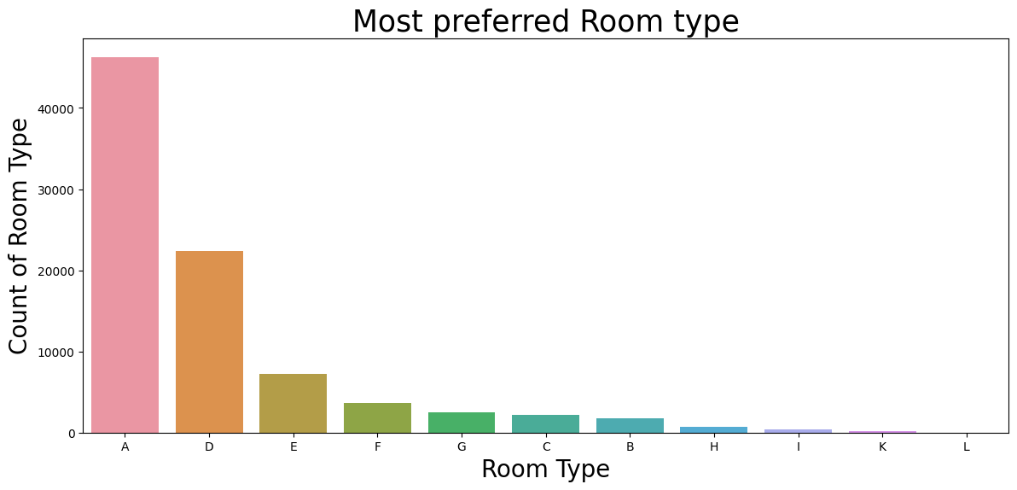
DATA VISUALISATION: Most Preferred Room Types by the guests
Inference
Most demanded room type is A followed by D and E

Slide 17
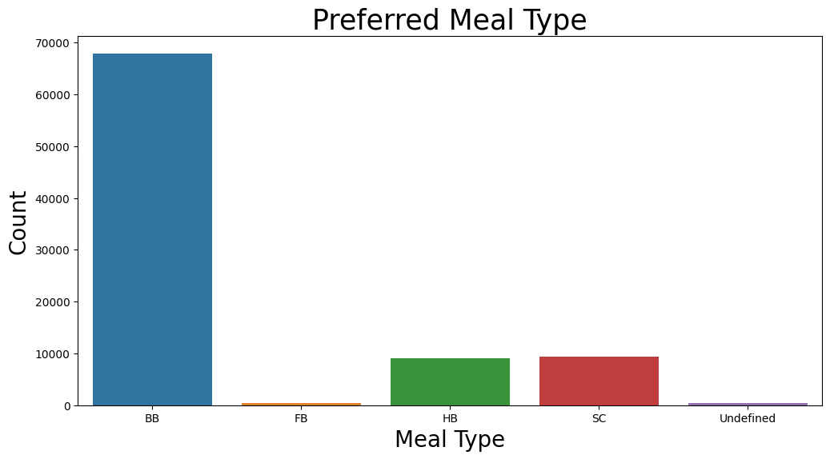
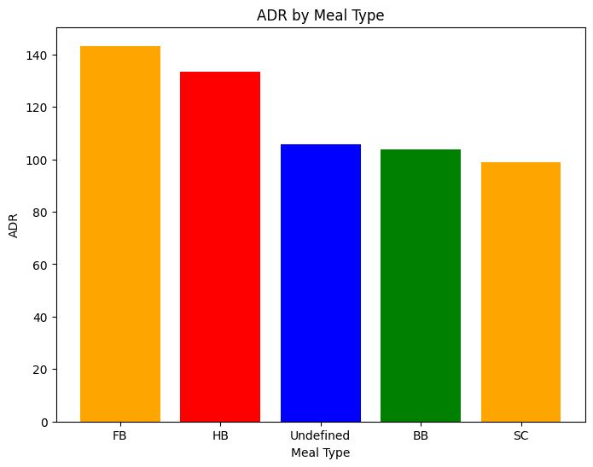
DATA VISUALISATION: Most Preferred Meal by the Guests
INFERENCE
The most preferred meal type by guests is BB(Bread and Breakfast)
HB(Half Board) and SC(Self Catering) are equally preferred
The observation that FB (Full Board) has the highest ADR (Average Daily Rate) while BB (Bread and Breakfast) is the most preferred meal type. Guests may choose BB as their preferred meal type because they perceive it to offer good value for money

Slide 18
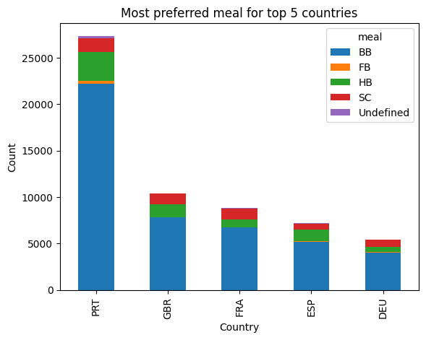
DATA VISUALISATION: Most Preferred Meal by the Guests of Top 5 Country
INFERENCE
All the top 5 countries prefer BB (Bread and Breakfast)
Next preferred Meal type is HB (Half Board)

Slide 19
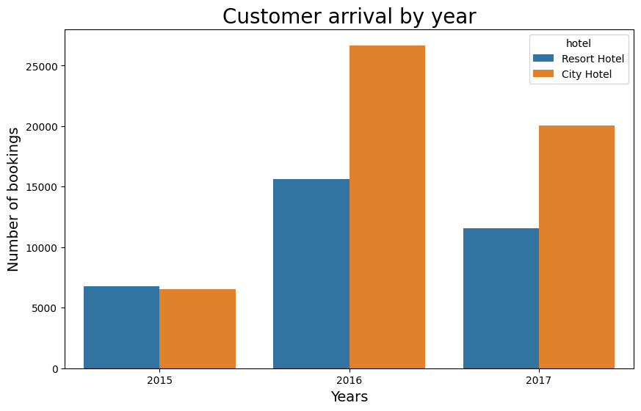
DATA VISUALISATION: Most Booking happened in which year
INFERENCE
As we can see 2016 is the year where most booking has been done.
Overall city hotel has been preferred rather than resorts.

Slide 20
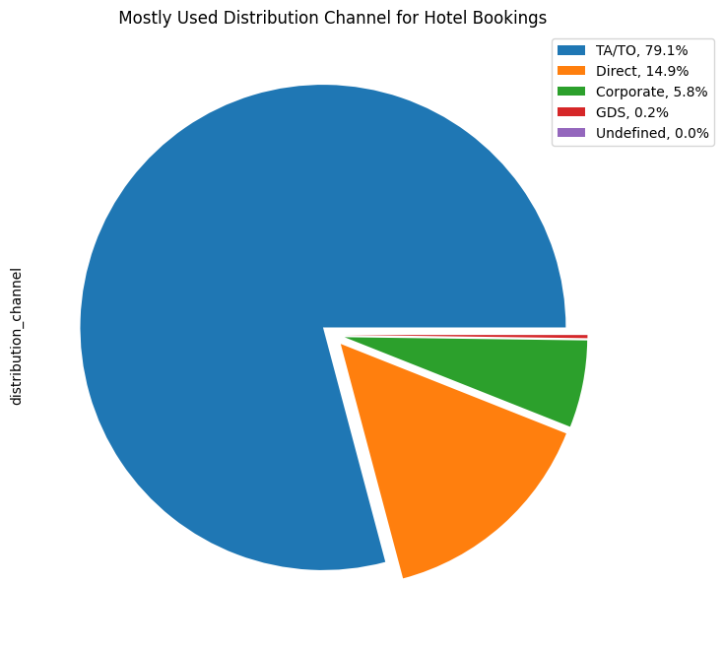
DATA VISUALISATION Distribution channel wise Analysis
INFERENCE
Here we can see most of guests are booking through TA/TO ,that is a travel agency. Then people are booking directly.
NOTE:
May be in future the TA/TO will monopolized the whole booking scene.

Slide 21
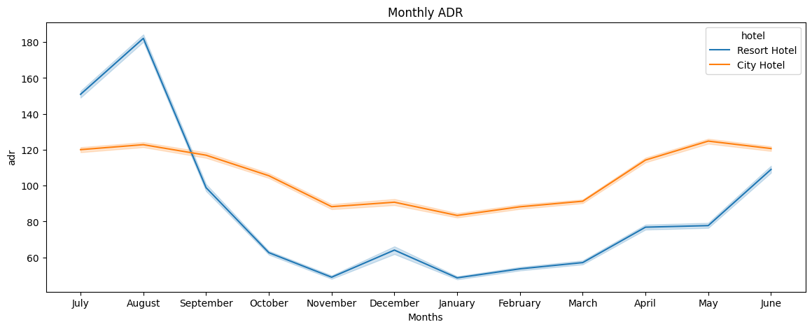
DATA VISUALISATION Trend of Monthly ADR for both Hotels
INFERENCE
Highest ADR generated by the hotels in month of August followed by July and June. Hotels generated more adr in the month of Summer.
Negative Trend has been noticed from the month of September to March. Lowest in the month of November and January.
Positive trend has been observed from the month of Mid-March to August.

Slide 22
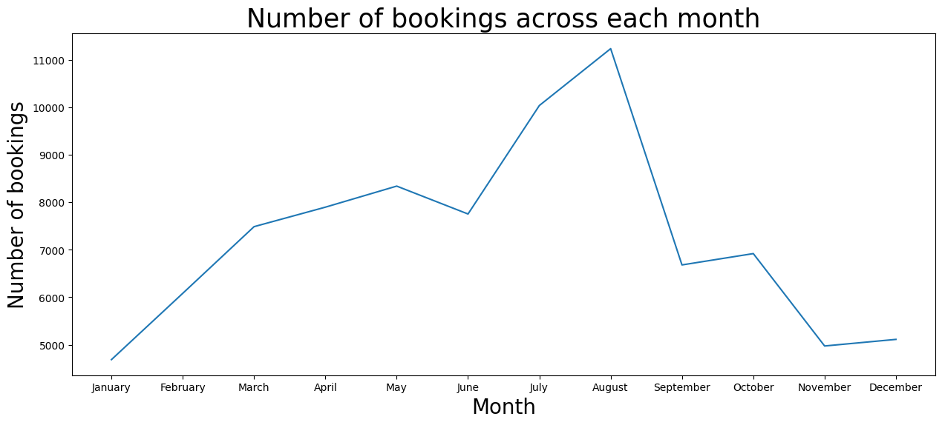
DATA VISUALISATION Number of Bookings across each month
INFERENCE
Highest Booking has been observed in the month of August.
Lowest Booking has been observed in the month of January.

Slide 23
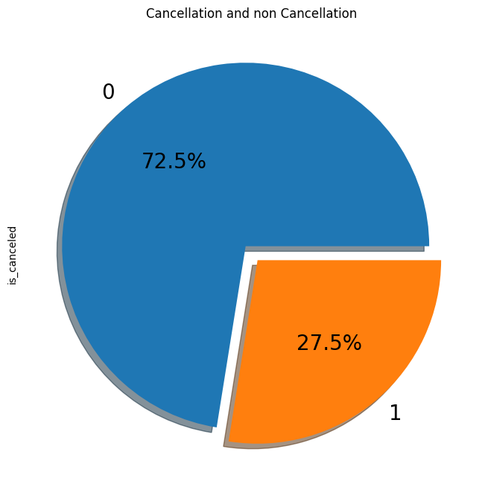
DATA VISUALISATION Percentage of Cancellation of Bookings
INFERENCE
Around 1/3rd of total bookings have been cancelled
0= Not Cancelled
1=Cancelled

Slide 24
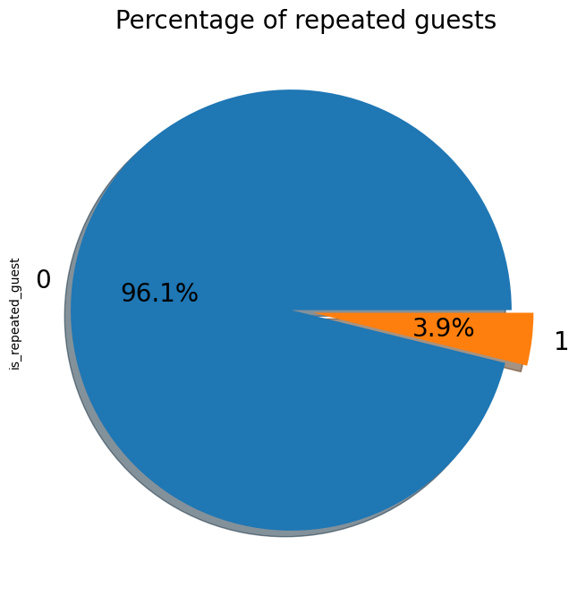
DATA VISUALISATION Percentage of Repeated Guests
INFERENCE
Only 4% percent of Guests repeat their bookings.
0= Not Repeated
1=Repeated

Slide 25
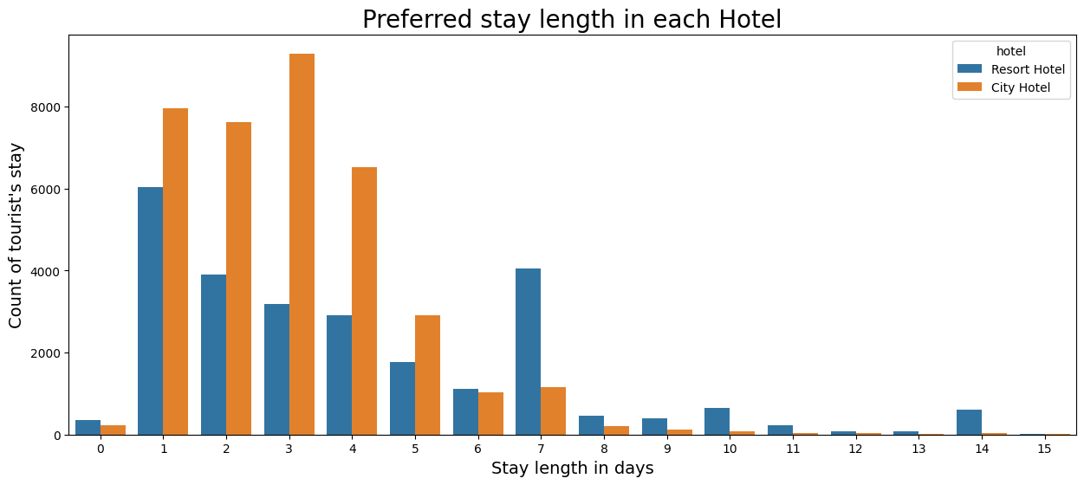
DATA VISUALISATION Length of stays in both hotels
INFERENCE
Most Guests usually stay 1-4 days for both instance.
Guests usually prefer City Hotels when they visit for shorter period i.e. 1-5 days.
Resorts are the 1st choice of guests who have plan for more than 5 days.

Slide 26
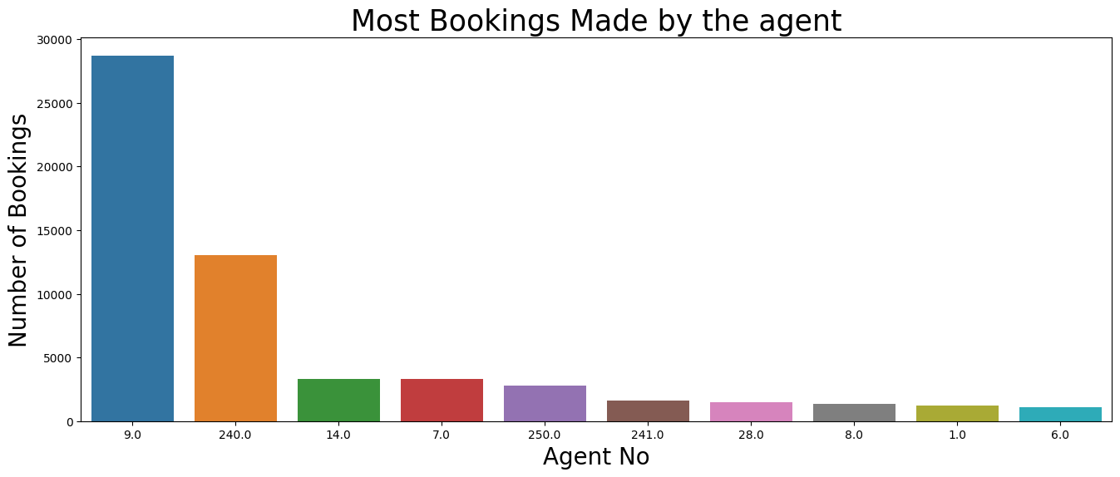
DATA VISUALISATION Most Bookings done by Top Agents
INFERENCE
Agent ID 9.0 has the highest number of bookings followed by 240.0

Slide 27
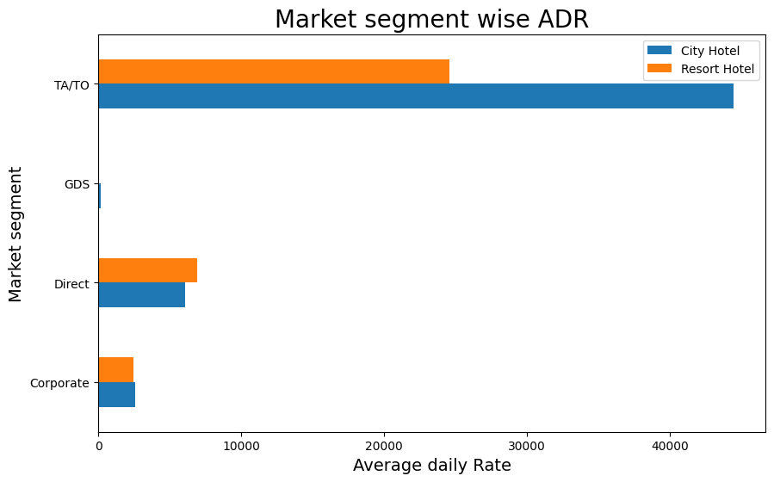
DATA VISUALISATION Which Distribution Channel has more adr
INFERENCE
This market segment refers to customers who make their hotel reservations through online travel agencies. Analyzing ADR for this segment helps hotels evaluate the effectiveness of their pricing strategies on different booking channels and identify any commission-related impacts on rates.
So TA/TO has the maximum adr rate. TA/TOs’ are monopolizing the Booking Contribution Section

Slide 28
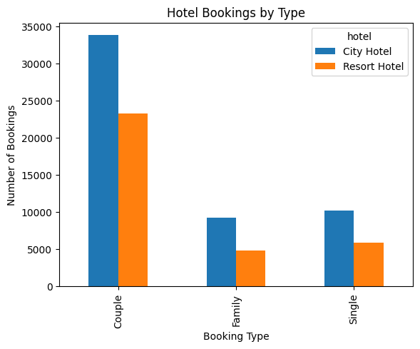
Data Visualization Which type of hotel guests come mostly
INFERENCE
Couple arriving percentage is quite higher in compare to family and single guests
It seems during long weekends or holiday periods, couples often take advantage of the time off to plan short trips or weekend getaways. This results in a surge in hotel bookings by couples during these periods.

Slide 29
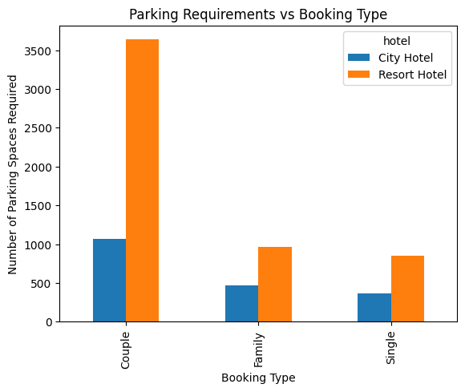
Data Visualization Parking requirements by guests
INFERENCE
Couples require much parking spaces than family and single and Resort hotel couple guest’s parking requirement are very higher in compare to city hotel.

Slide 30
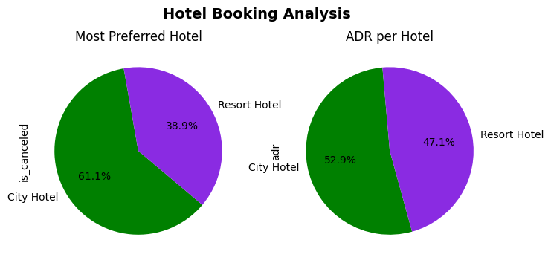
DATA VISUALISATION Which hotel contribute more ADR to the Hotel Business
INFERENCE
Booking wise City Hotel contributes around 68%.
But when comes to ADR generation the contribution is almost same. City Hotel contributes almost 53% whereas Resort Hotels contributes around 47%

Slide 31
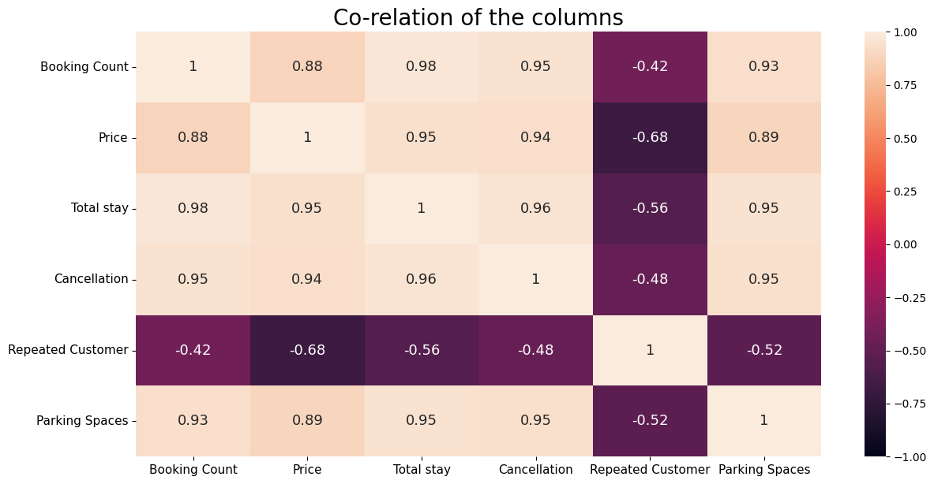
Data Visualization Correlation Analysis of Hotel Booking Factors
INFERENCE
There is a high positive correlation between Booking and Pricing, Total Stay, Cancellations and Parking spaces, where as negative correlation with Repeated guests
Increase in Pricing leads to repeated Customers not visiting again
There is firm correlation between Parking space and Cancellation inferring that people are more likely to cancel their booking if Parking space is not available.

Slide 32
BUSINESS OBJECTIVE :
We are able to show the things to the client which Hotel is most preferred , the percentage of repeated guests , mostly preferred food by guests , then which hotel has the highest adr , etc.
By focusing on these key business objectives in hotel booking analysis, hotels can optimize revenue, enhance customer experiences, improve operational efficiency, refine marketing strategies, and gain a competitive advantage in the dynamic hospitality industry.

Slide 33
Conclusion
Majority (61%) of the guests prefer City Hotel over Resort Hotel. Most of guest visiting these hotels are from European countries namely Portugal, Britain, France, Spain and Germany totaling to 75% of total booking count.
The year 2016 observed the highest booking reservations.
Around 11.5% of total reservations throughout year are coming from August whereas January has the least reservation of mere 5%.
Inspecting different market segments, it was concluded that travel agency holds monopoly as both hotels are getting the most of booking from travel agency (around 79%)
Only 3.9 % people revisited the hotels. Rest 96.1 % were new guests. Thus retention rate is low.
Ideally guest prefer to stay 1-4 days in both hotels but 7 days stay at Resort hotel is also a popular choice among guests.
There is firm correlation between Parking space and Cancellation inferring that people are more likely to cancel their booking if Parking space is not available.

Slide 34
Thank You

